Slide 1
Fault Diagnosis with Machine Learning Methods
Jiachang Xu
1819235
MSc Data Science
supervised by Dr. Hak-Keung Lam

Slide 2
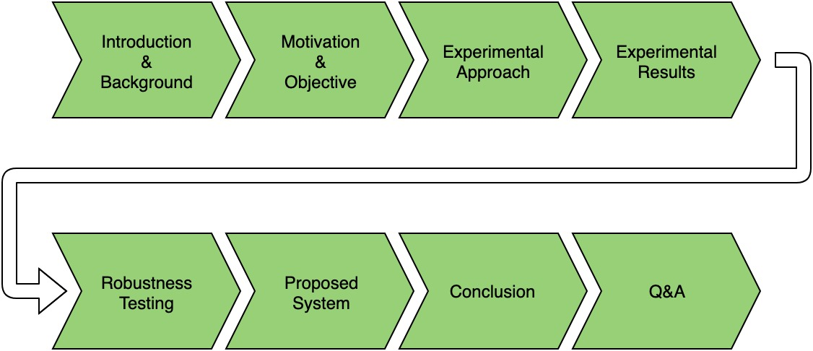
Agenda

Slide 3
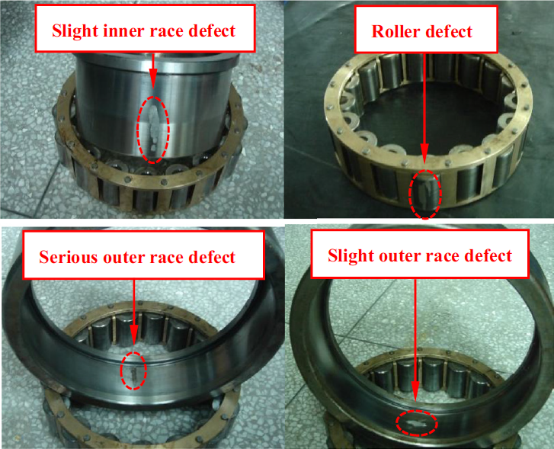
Introduction & Background
What components does a rolling-element bearing have?
Why is bearing fault diagnosis important?
What do previous researches say?
Source of Figure: https://www.sciencedirect.com/science/article/abs/pii/S0950705116305068

Slide 4
Motivation & Objectives
What is the most effective composite selection of features under the realm of traditional statistical analysis and ensemble empirical mode decomposition (EEMD) method in a controlled environment, which is defined by a shallow classification model?
Source of Figure: https://www.khanacademy.org/science/high-school-biology/hs-biology-foundations/hs-biology-and-the-scientific-method/a/experiments-and-observations

Slide 5
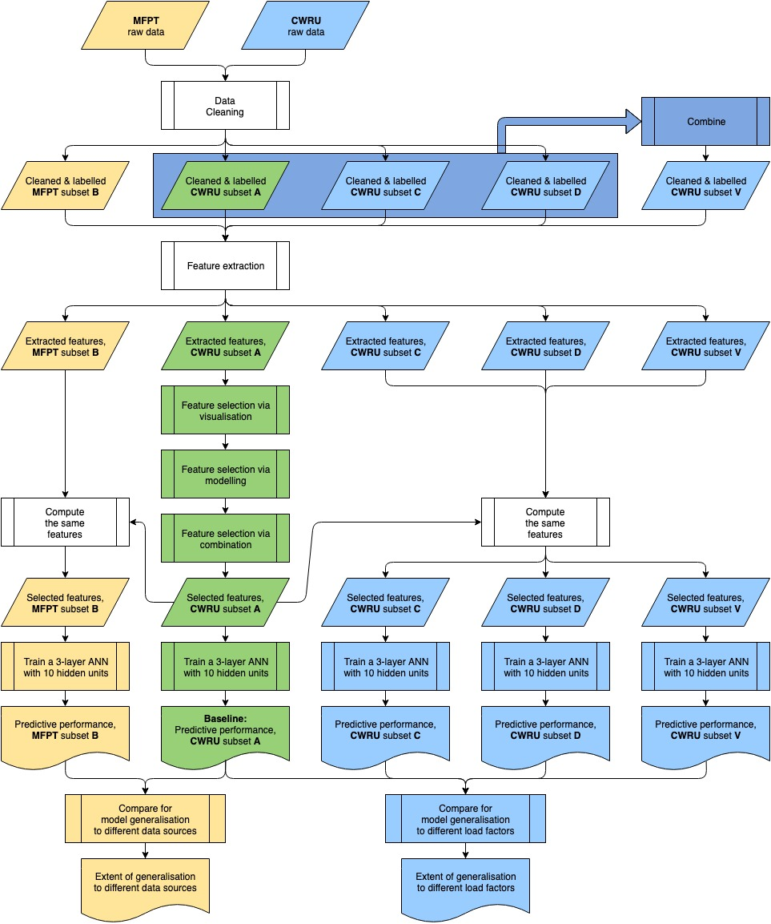
Experimental Approach
The flowchart of the experimental procedures of this project

Slide 6
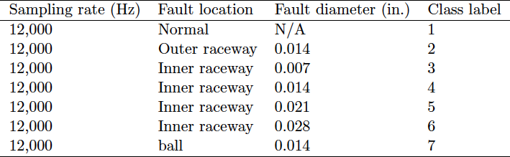
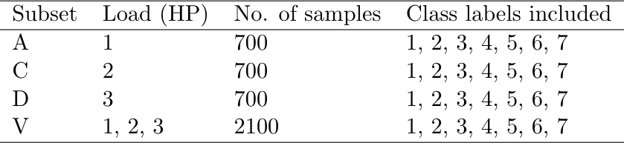
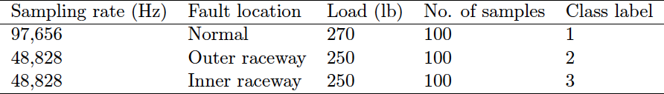
Data Description & Partition
CWRU experimental data description
Case Western Reserve University (CWRU)
Which features are discriminative?
Generalise to different load factors?
Society For Machine Failure Prevention Technology (MFPT)
Generalise to different data sources?
CWRU experimental data partition
MFPT experimental data description
Notes:
Explain why to choose these classes for CWRU data
Identify different fault locations
Identify different fault diameters
Demo a_combined_cleaning.m (NOT running)

Slide 7
Feature Extraction
Traditional Statistical Analysis
6 time-domain features
13 frequency-domain features
Ensemble Empirical Mode Decomposition (EEMD) method
4 time-domain features
3 frequency-domain features
Source of Figures: https://uk.mathworks.com/help/matlab/ref/fft.html
Notes:
Explain traditional statistical analysis
Explain EEMD method:
Run M ensembles for each signal sample. In each ensemble:
Add white noise to each signal sample
Use EMD to decompose the noise-added signal into I IMFs
Return the average of M trials as the final value of each IMFs
Select the most sensitive IMF
Compute specified features on the sensitive IMF
Explain the challenge of running FFT on noisy signal

Slide 8
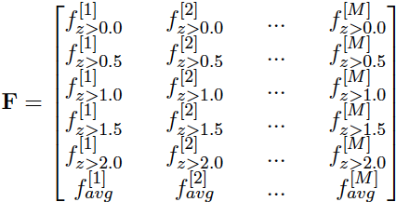
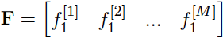
Feature Representation
Time-domain features
Frequency-domain features

Slide 9
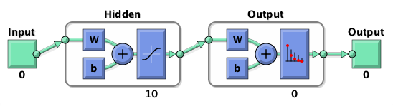
Model Architecture
A 3-layer ANN model (i.e. 1 input layer, 1 hidden layer, and 1 output layer)
Serves as the controlled environment
Train-Validate-Test ratio = 70%-15%-15%

Slide 10
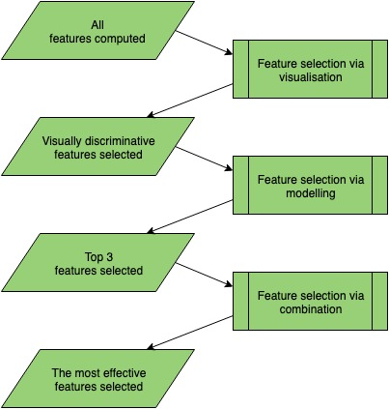
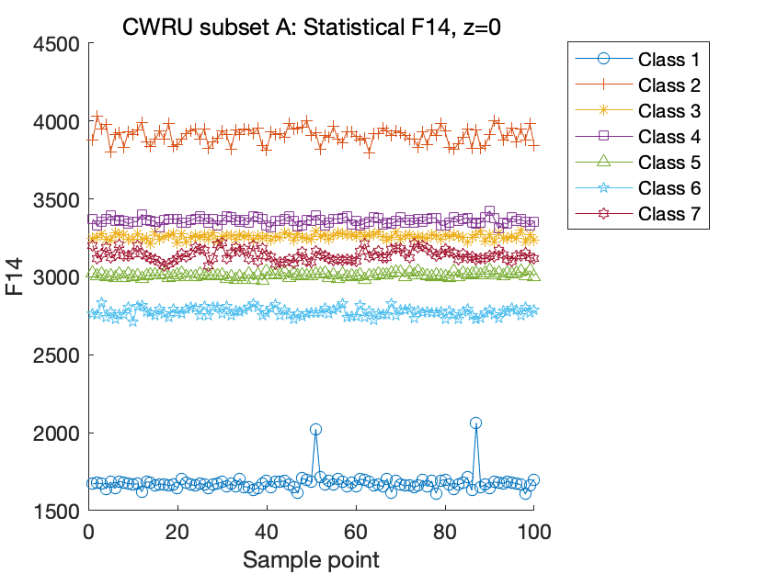
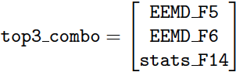
Feature Selection
Via visualisation
Via modelling
Via combination
Notes:
Demo a_stats_F14_freq_visualisation.m
Demo a_combined_extraction.m (NOT running)
Demo a_EEMD_F1_patternnet.m
Demo a_EEMD_F5_patternnet.m
Demo a_EEMD_F6_patternnet.m
Demo a_stats_F14_patternnet.m
Demo a_stats_F19_patternnet.m
Demo a_top3_features_patternnet.m

Slide 11
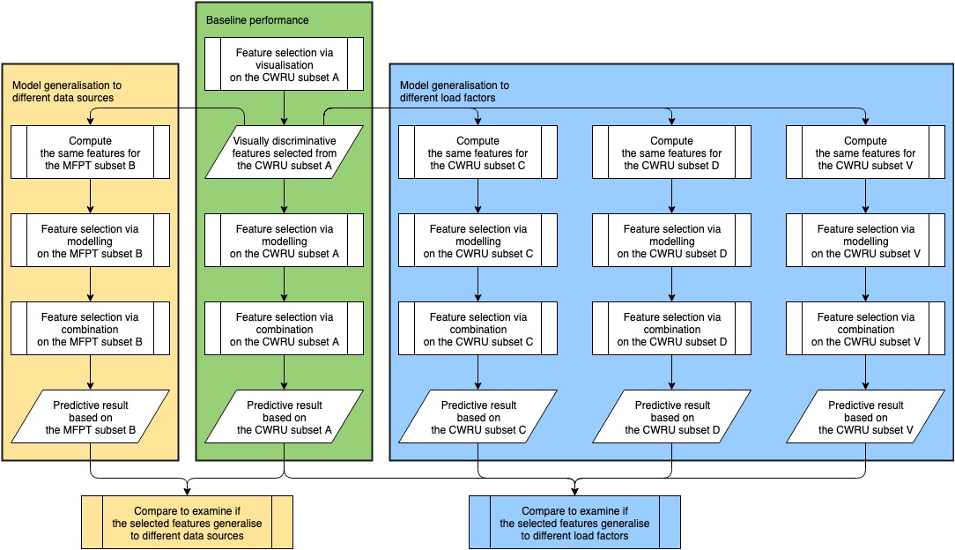
Model Generalisation
Examines whether the selected features from CWRU subset A generalise to different data sources and different load factors
Notes:
Demo b_top3_features_patternnet.m
Demo c_top3_features_patternnet.m
Demo d_top3_features_patternnet.m
Demo v_top3_features_patternnet.m

Slide 12
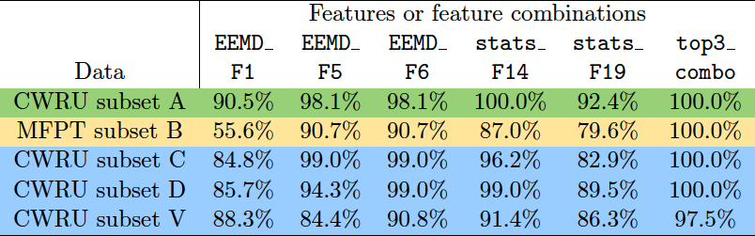
Experimental Results
Testing accuracies of visually discriminative features and combination of top 3 candidate features on different subsets

Slide 13
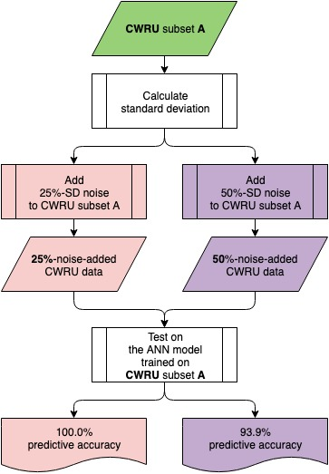
Robustness Testing
Examines how the trained model will perform on noise-added data
Notes:
Demo z_top3_features_patternnet.m

Slide 14
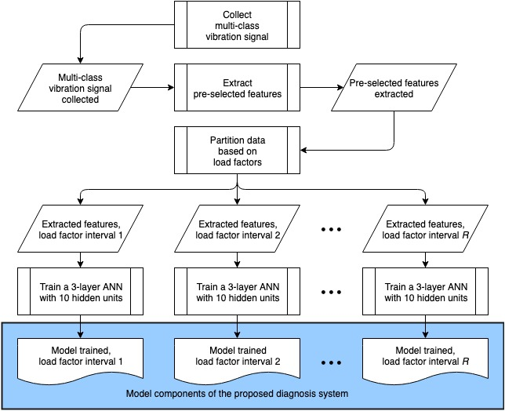
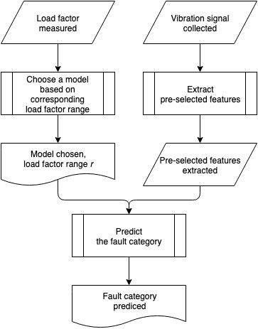
Proposed Fault Diagnosis System
Construction of the System
Workflow of the System

Slide 15
Conclusion
A solution of z-score threshold
An effective composite selection of features
Generalises to different data sources
Generalises to different load factors
A proposed fault diagnosis system
Room for improvement?

Slide 16
Questions?

